Slide 1
Food Booking App Design
Varun B P

Slide 2
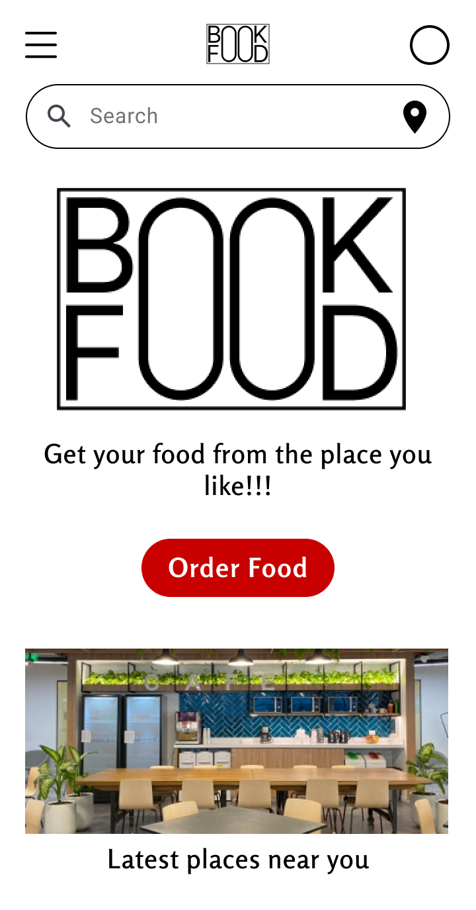
Project overview
The product:
BOOK FOOD, the app for effortless food ordering and instant booking from your favorite restaurants and eateries. Whether you're a busy professional squeezing in a quick lunch or a student craving a late-night snack, BOOK FOOD simplifies the entire process, ensuring you get your desired meal with just a few taps on your smartphone.
Project duration:
1 month

Slide 3
Project overview
The problem:
Many struggle with long waits and inconvenience when ordering food. We need a solution for instant food booking, catering to busy professionals and students seeking quick, hassle-free meals.
The goal:
Design a Book Food app to be user friendly by providing clear navigation and offering a fast booking and checkout process.

Slide 4
Project overview
My role:
UX designer leading the Book Food app design
Responsibilities:
Conducting interviews, paper and digital wireframing, low and high-fidelity prototyping, conducting usability studies, accounting for accessibility, iterating on designs and responsive design.

Slide 5
User research
Personas
Problem statements
User journey maps
Understanding
the user

Slide 6
User research: summary
I conducted user interviews to gain insights into the target audience's needs and preferences, which I then translated into empathy maps to deepen my understanding. What emerged was a clear picture: many users view ordering food online as a convenient and enjoyable break from their busy schedules. However, existing food ordering platforms often fail to provide a seamless and user-friendly experience, leading to frustration and disappointment.

Slide 7
User research: pain points
1
2
3
Complex Interfaces
Time-consuming Process
Frustration with Errors
Users are overwhelmed by cluttered and confusing interfaces, hindering their ability to navigate and place orders efficiently
Excessive time spent navigating menus and options detracts from the convenience online ordering should offer, causing frustration and inconvenience.
Technical glitches, order inaccuracies, and payment issues lead to dissatisfaction and undermine trust in the platform, resulting in a negative user experience.

Slide 8
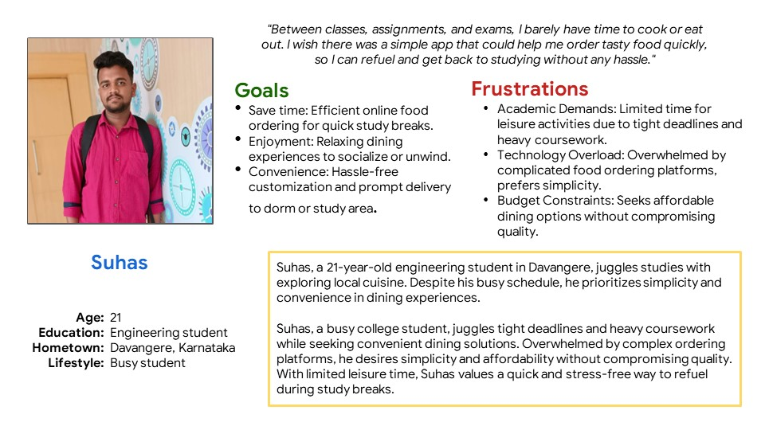
Persona: Suhas
Problem statement:
Suhas is a busy college student who needs a simple app that could help him to order his liking food quickly, so not to wait in queues to order food.

Slide 9
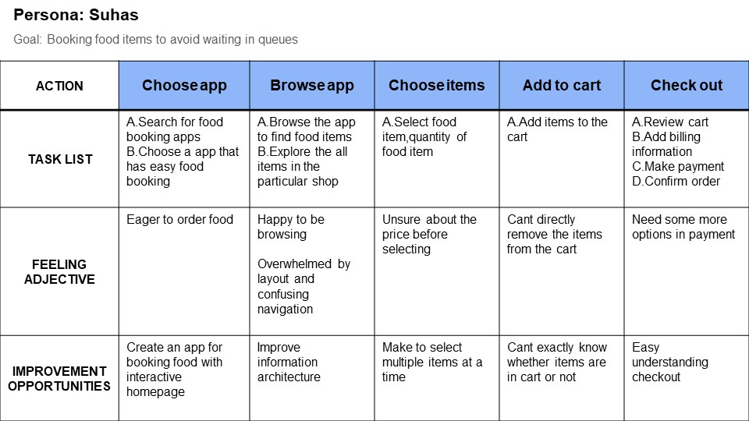
User journey map
I created a user journey map of Suhas’s experience using the site to help identify possible pain points and improvement opportunities.

Slide 10
Sitemap
Paper wireframes
Digital wireframes
Low-fidelity prototype
Usability studies
Starting
the design

Slide 11
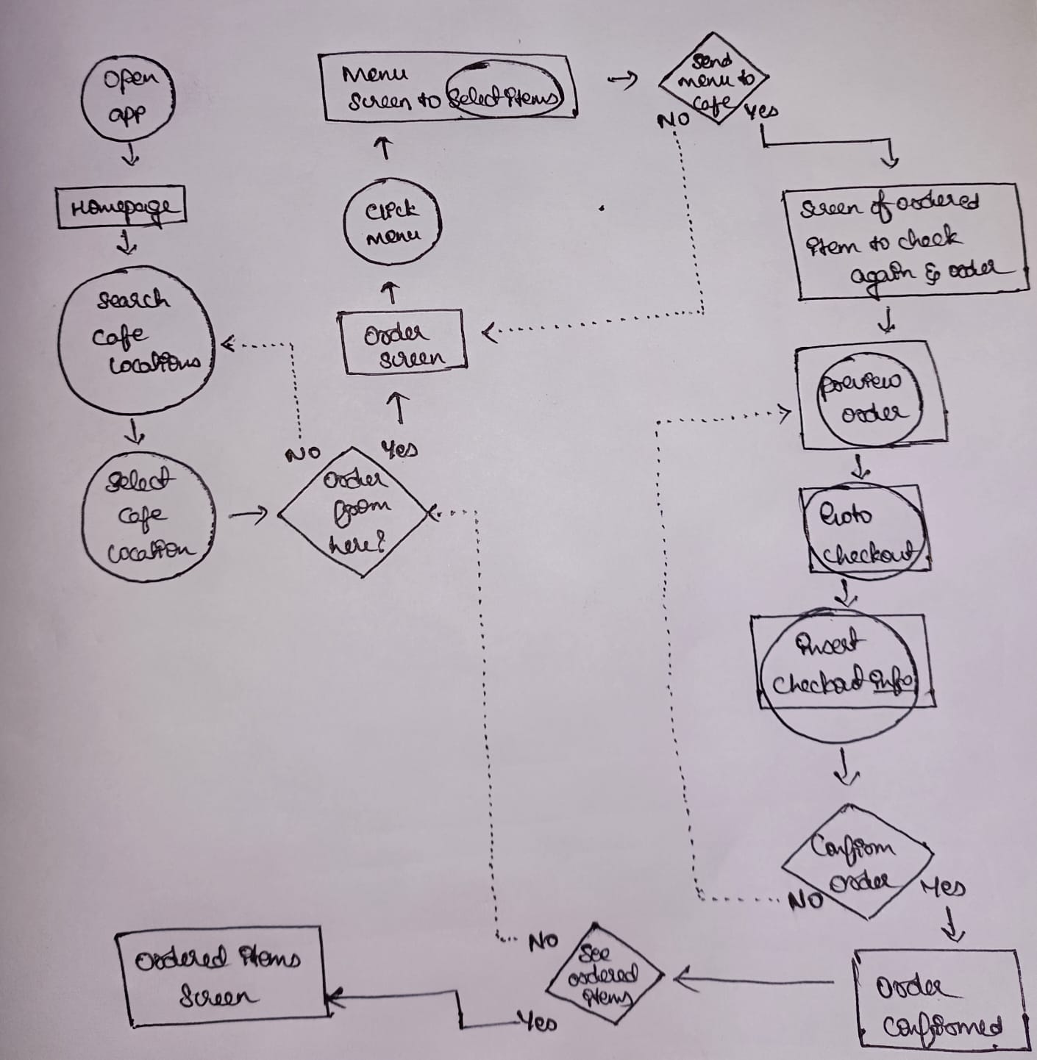
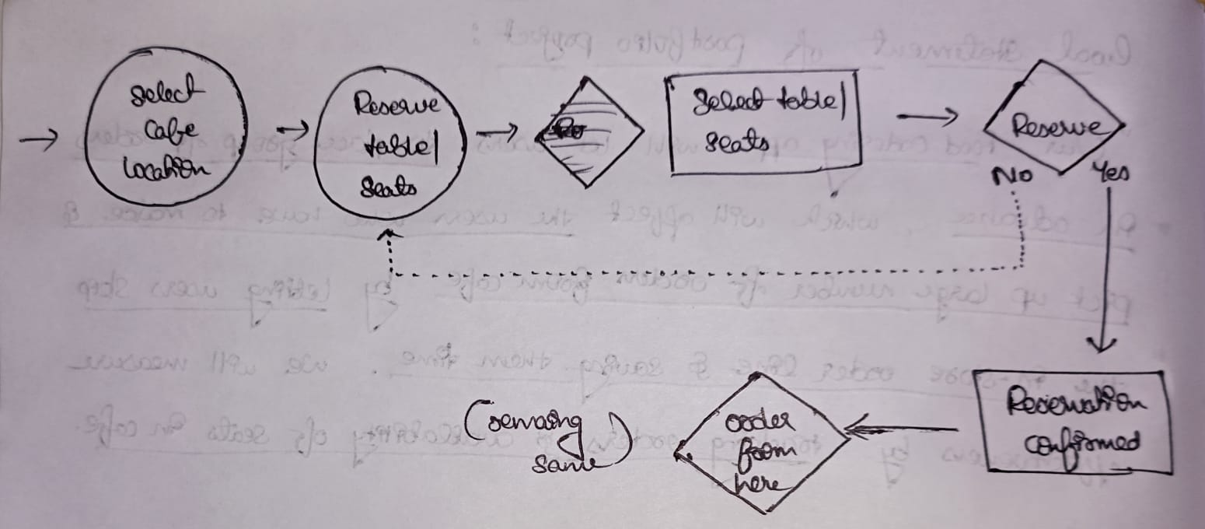
Sitemap
Users grapple with cluttered interfaces, leading to inefficient navigation and frustration. Technical glitches and order inaccuracies further diminish trust and satisfaction.
Goal: Simplify interface design and enhance system reliability to streamline navigation and ensure error-free ordering experiences, fostering trust and satisfaction among users.

Slide 12
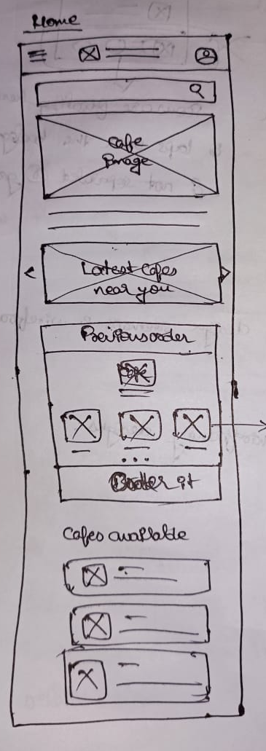
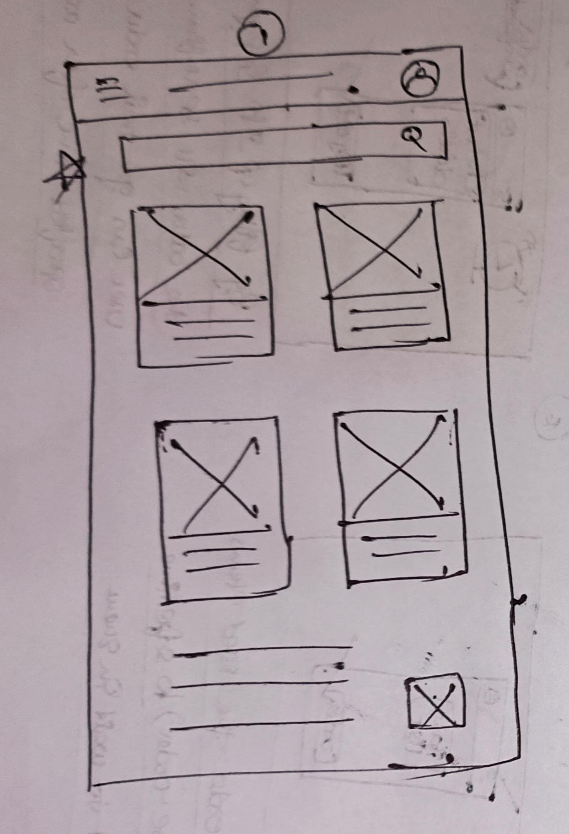
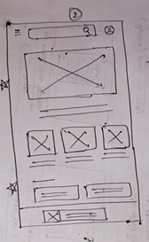
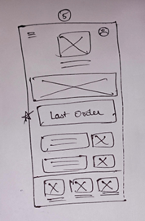


Paper wireframes
Next, I sketched out paper wireframes for each screen in my app, keeping the user pain points about navigation, browsing, and checkout flow in mind.
The home screen paper wireframe variations to the right focus on optimizing the browsing experience for users.
Refined paper wireframe
Stars were used to mark the elements of each sketch that would be used in the initial digital wireframes.

Slide 13
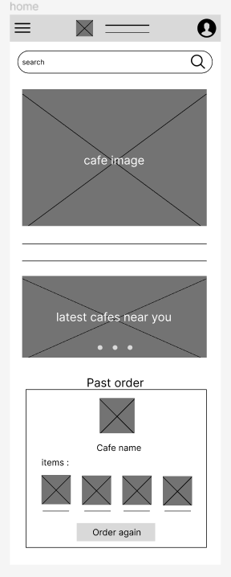
Digital wireframes
Homepage is optimized for easy browsing through the carousel of images and nav menu options
Moving from paper to digital wireframes made it easy to understand how the redesign could help address user pain points and improve the user experience.
Prioritizing useful button locations and visual element placement on the home page was a key part of my strategy.

Slide 14
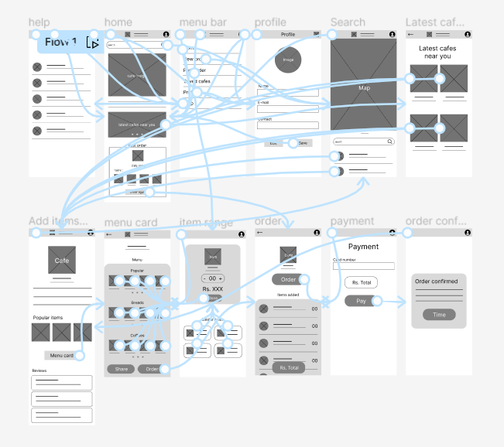
Low-fidelity prototype
To create a low-fidelity prototype, I connected all of the screens involved in the primary user flow of adding an item to the cart and checking out.
At this point, I had received feedback on my designs from members of my team about things like placement of buttons and page organization. I made sure to listen to their feedback, and I implemented several suggestions in places that addressed user pain points.
View Book Food’s low-fidelity prototype

Slide 15
Usability study: parameters
Study type:
Unmoderated usability study
Location:
Davangere, Karnataka
Participants:
5 participants
Length:
20-30 minutes

Slide 16
Usability study: findings
These were the main findings uncovered by the usability study:
1
2
3
Cart
Checkout
Account
Once at the checkout screen, users didn’t have a way to edit the quantity of items in the cart
Users weren’t able to easily copy the shipping address information into the billing info field
During the checkout process, there wasn’t a clear way for users to log in to their account to pre-fill previous billing and shipping info

Slide 17
Refining
the design
Mockups
High-fidelity prototype
Accessibility

Slide 18
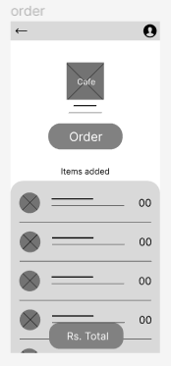
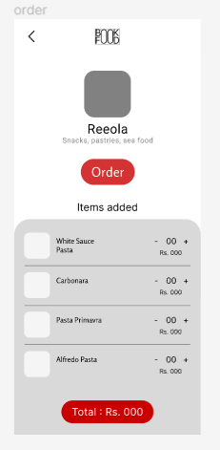
Mockups
Based on the insights from the usability study, I made changes to improve the site’s checkout flow. One of the changes I made was adding the option to edit the quantity of items in a user’s cart using a simple “+” or “-” option. This allowed users more freedom to edit their cart without going through a complicated process to add or remove items.
Before usability study
After usability study

Slide 19
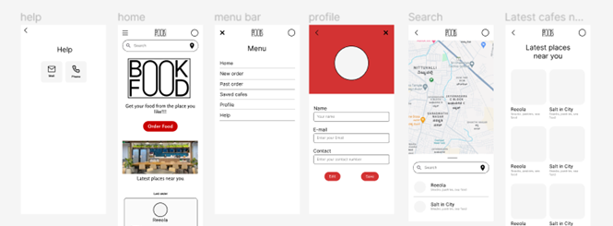
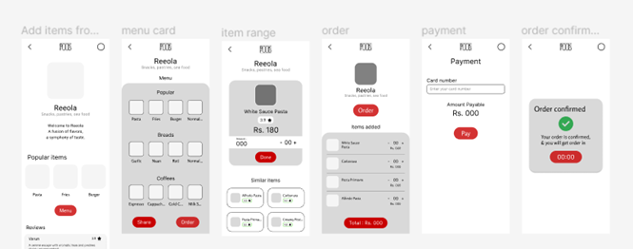
Mockups: Original screen size

Slide 20
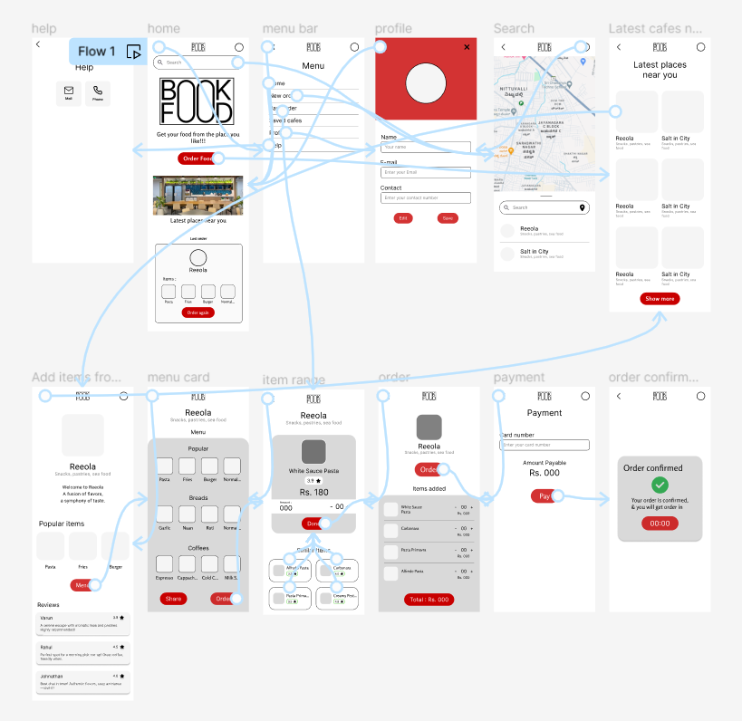
High-fidelity prototype
My hi-fi prototype followed the same user flow as the lo-fi prototype, and included the design changes made after the usability study, as well as several changes suggested by members of my team.
View the Book Food’s high-fidelity prototype

Slide 21
Accessibility considerations
1
2
3
I used headings with different sized text for clear visual hierarchy
I used landmarks to help users navigate the site, including users who rely on assistive technologies
I designed the site with alt text available on each page for smooth screen reader access

Slide 22
Going forward
Takeaways
Next steps

Slide 23
Takeaways
Impact:
Our target users shared that the design was intuitive to navigate through, and shared that they have easy and simple checkout.
What I learned:
I learned that even a small design change can have a huge impact on the user experience. The most important takeaway for me is to always focus on the real needs of the user when coming up with design ideas and solutions.

Slide 24
Next steps
1
2
Conduct follow-up usability testing on the new website
Identify any additional areas of need and ideate on new features

Slide 25
Let’s connect!
Thank you for reviewing my work on the Book Food’s app!
If you’d like to see more, or would like to get in touch, my contact information is provided below:
Email: varunbp98@gmail.com

